Slide 1
Pattern Recognition
吴庭明
51151500059
2016/06/23

Slide 2
Reference paper
Human Action Recognition using Depth Maps
  Vennila Megavannan
  Bhuvnesh Agarwal
  R. Venkatesh Babu

Slide 3
Roadmap
Action Representation
  Motion history image
  Average Depth Image
  Depth Difference Image
Implementation
  Tools and dataset
  Feature extraction results
  Training
  Testing

Slide 4




Motion History Image

Slide 5
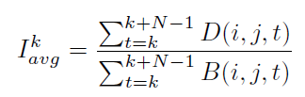
Average Depth Image

Slide 6
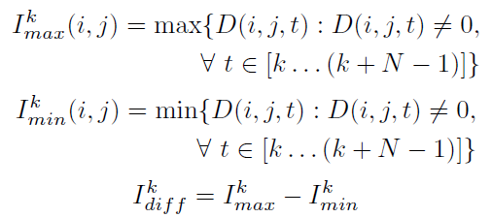
Depth Difference Image

Slide 7
Roadmap
Action Representation
  Motion history image
  Average Depth Image
  Depth Difference Image
Implementation
  Tools and dataset
  Feature extraction results
  Training
  Testing

Slide 8
Information
Tools
  Visual Studio 2010
  Opencv 2.4.10
  LibSVM 3.2.1
Dataset
  Different kind of motion videos
    Bend, bowling, box, jump, kick, squat, strength, swim, trumble, wave
  Each video contains 19 frames
  Depth Image

Slide 9
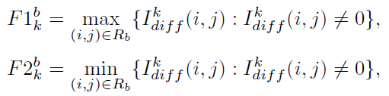
Action Representation
Cut all videos into frames
Bounding box features
  Compute depth difference image(DDI) for each class
  Extract 108 features from different windows each of different size
Hu Moments features
  Compute motion history image(MHI) for each class
  Compute for each class average depth image(ADI)
  Extract 14 features from depth different image

Slide 10
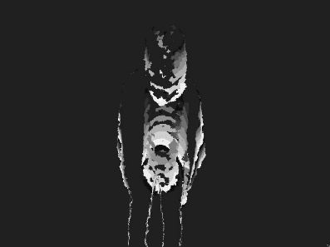
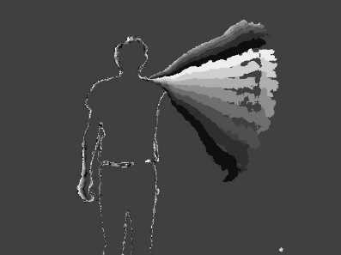
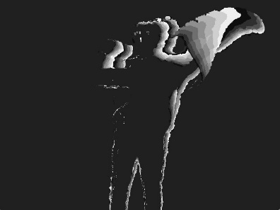
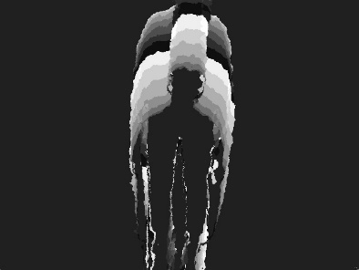
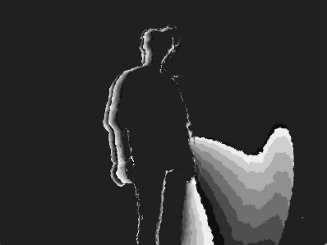
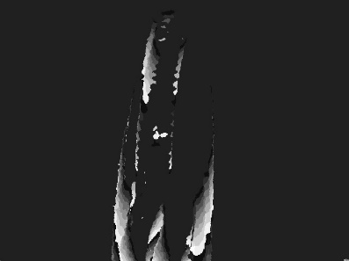
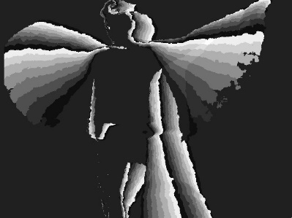
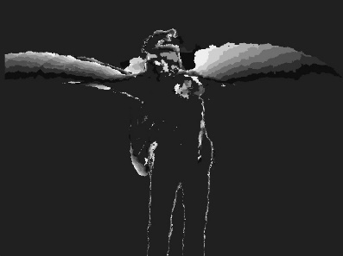
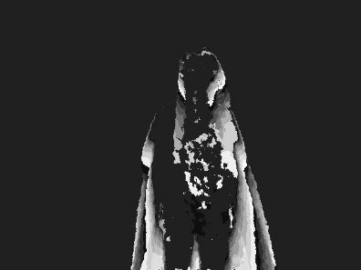
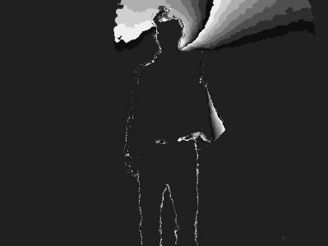
Action Representation
MHI
bend
bowling
box
jump
kick
squat
strenth
swim
tumble
wave

Slide 11
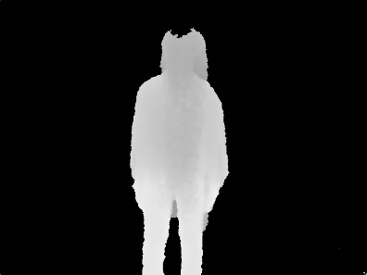
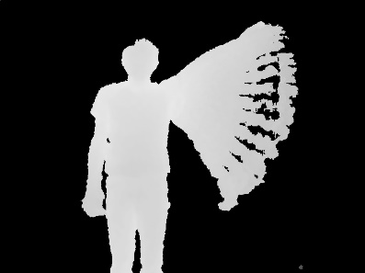
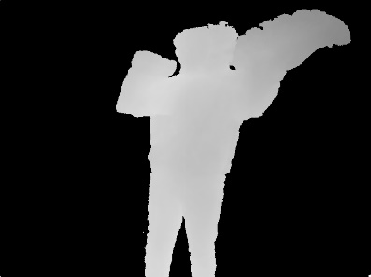
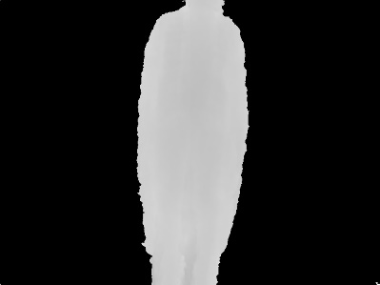
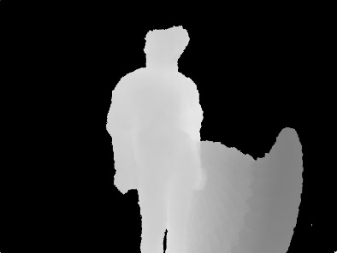
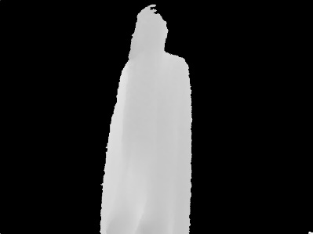
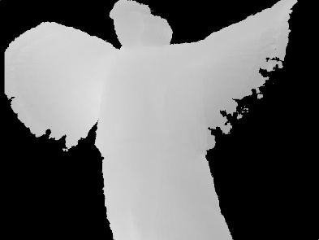
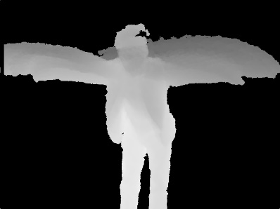
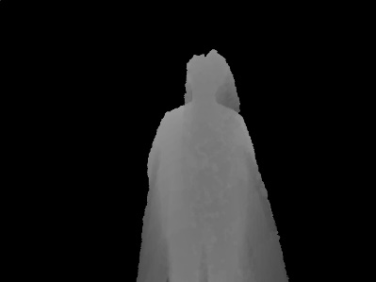
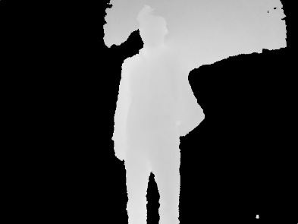
Action Representation
ADI
bend
bowling
box
jump
kick
squat
strenth
swim
tumble
wave

Slide 12
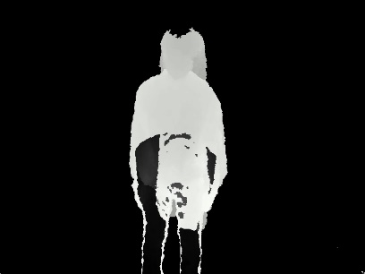
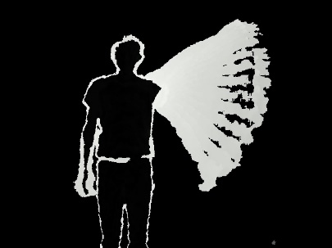
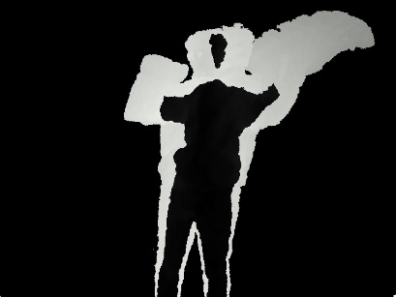
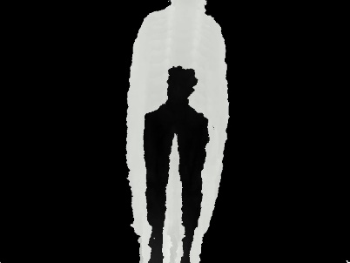
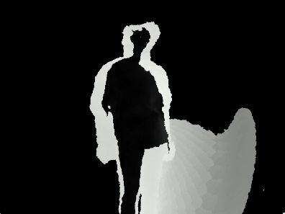
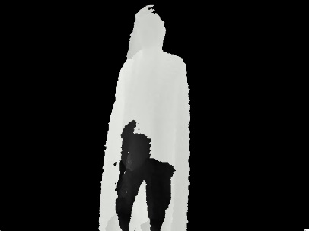
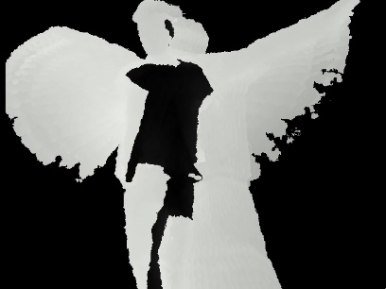
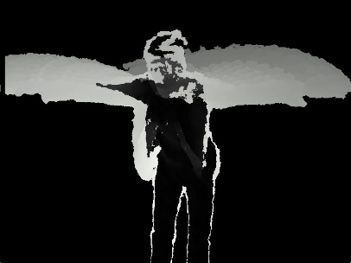
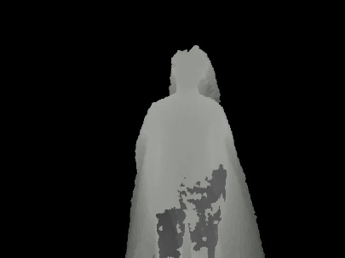
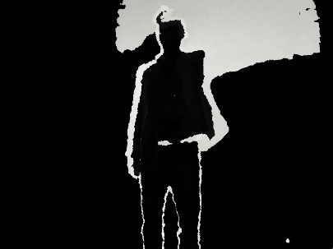
Action Representation
DDI
bend
bowling
box
jump
kick
squat
strenth
swim
tumble
wave

Slide 13
Training & Testing
SVM Type
  C-SVC (multi-class classification)
Kernel
  Linear
    108(DDI)
      Cross Validation Accuracy = 95.1872%
      Accuracy = 100% (20/20) (classification)
    14
      Cross Validation Accuracy = 23.5294%
      Accuracy = 25% (5/20) (classification)

Slide 14
Training & Testing
SVM Type
  C-SVC (multi-class classification)
Kernel
  polynomial
    108(DDI)
      Cross Validation Accuracy = 94.1176%
      Accuracy = 100% (20/20) (classification)
    14
      Cross Validation Accuracy = 10.1604%
      Accuracy = 10% (2/20) (classification)

Slide 15
Training & Testing
SVM Type
  C-SVC (multi-class classification)
Kernel
  RBF
    108(DDI)
      Cross Validation Accuracy = 20.3209%
      Accuracy = 20% (4/20) (classification)
    14
      Cross Validation Accuracy = 22.9947%
      Accuracy = 25% (5/20) (classification)

Slide 16
Training & Testing
SVM Type
  C-SVC (multi-class classification)
Kernel
  108(MHI)
    Linear
      Cross Validation Accuracy = 97.3262%
      Accuracy = 95% (19/20) (classification)
    Polynomial
      Cross Validation Accuracy = 96.7914%
      Accuracy = 95% (19/20) (classification)

Slide 17
Training & Testing
SVM Type
  C-SVC (multi-class classification)
Kernel
  108(ADI)
    Linear
      Cross Validation Accuracy = 10.1604%
      Accuracy = 10% (2/20) (classification)
    Polynomial
      Cross Validation Accuracy = 10.1604%
      Accuracy = 10% (2/20) (classification)

